Slide 1

Final Presentation Autonomous Systeme (LRG6300) 24WS Prof. Dr.-Ing. Markus Ryll
Team 11
Siyan Li RCI
Bingkun Huang MRBE
Zhenjiang Li RCI
Haowen Shi MRBE
Weili Tang Aerospace
04. March 2025, Technical University of Munich
Notes:
Glad

Slide 2
Content
Overall system
Perception
Objects of interest
Trajectory generation
Controller
Path planner
Notes:
contain 4 parts

Slide 3
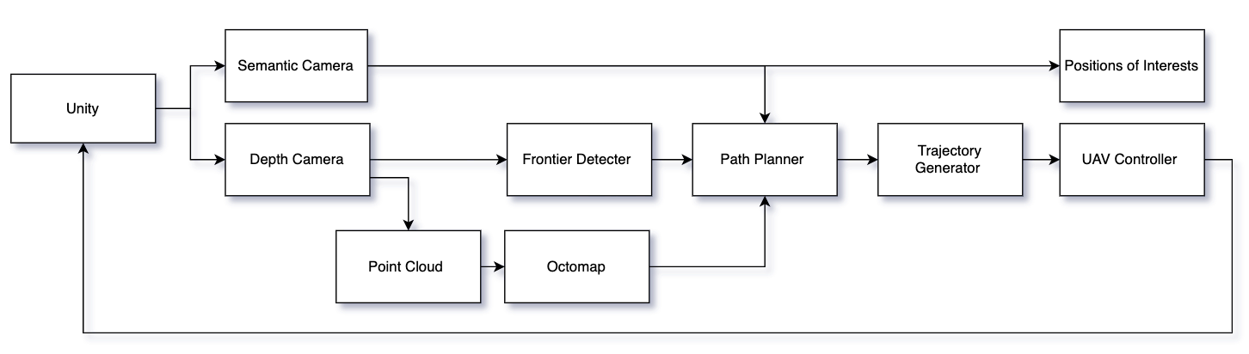
Overall System
Notes:
contain 4 parts

Slide 4
Perception: Octmap generation- pointcloud
(0, 0)
u
d: Depth value of pixel
v
(pu, py, 1)_c: depth pixel
(cx, cy, 0)_c: camera
Depth frame
(0, 0, 0)_w: World coordinate
Notes:
two ideas- one informed by using another

Slide 5
Perception: Octmap generation- pointcloud
(0, 0)
u
Point position wrt. Camera frame
d: Depth value of pixel
v
(pu, py, 1)_c: depth pixel
(cx, cy, 0)_c: camera
Point position wrt. World frame
TF_W2C
Depth frame
(0, 0, 0)_w: World coordinate
Notes:
two ideas- one informed by using another

Slide 6
Perception: Octmap generation- voxel grid
(0, 0)
Ray
v
(u,v)
Camera
Voxel grid
Depth image plane
(0, 0, 0)_w: World coordinate
Notes:
two ideas- one informed by using another

Slide 7
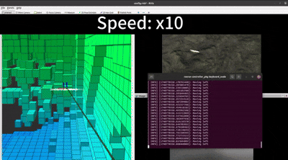
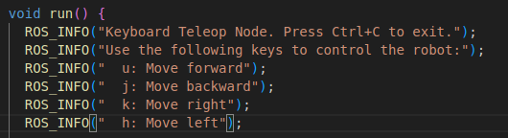
Perception: Environmental Exploration
Idea: Explore the task environment by manully manipulating the drone to explore the cave to help up analyse the task.
Solution: Remote the drone with keyboard input.
Command to control the drone
manipulating drone to explore the cave
Notes:
two ideas- one informed by using another

Slide 8
Objects of interest detector: Overview
Purpose of the node: To detect and localize a specific object using semantic (RGB) and depth images.
Depth image input
Detected object’s 3D position
Interest detector
Semantic image input
Mark the locations of objects of interest on the Rviz map
Camera parameters
Notes:
two ideas- one informed by using another

Slide 9
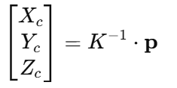
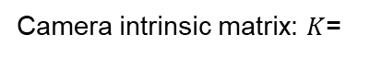
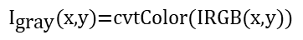

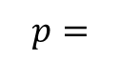
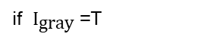
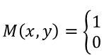
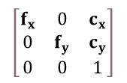
Objects of interest detector : Algorithm Details
Semantic Image Processing
Convert the RGB image to grayscale:
$${\text{​}I}_{\text{gray}}\text{(}\text{x}\text{,}\text{y}\text{)=}\text{cvtColor}\text{(}\text{IRGB}\text{​(}\text{x}\text{,}\text{y}\text{))}$$
Apply thresholding with a threshold T to create a binary mask:
$$M\left(x,y\right)=\left\{\begin{aligned}1 \\ 0\end{aligned}\right.$$
if ${\text{​}I}_{\text{gray}}$=T
​otherwise
Compute the centroid from the bounding box:
Depth Image Processing & 3D Reconstruction
Retrieve the depth value z (in m) at the centroid and convert to meters:
$$z_{\text{meter}}=\frac{z}{1000}$$
$$\left[\begin{matrix}f_{x} & 0 & c_{x} \\ 0 & f_{y} & c_{y} \\ 0 & 0 & 1\end{matrix}\right]$$
Camera intrinsic matrix: $K$=
Form the homogeneous coordinate vector:
$$p=$$
Compute the 3D point in the camera frame:
Coordinate Transformation via TF
Use the TF transformation to convert the 3D point from the camera frame to the world frame:
Notes:
two ideas- one informed by using another

Slide 10
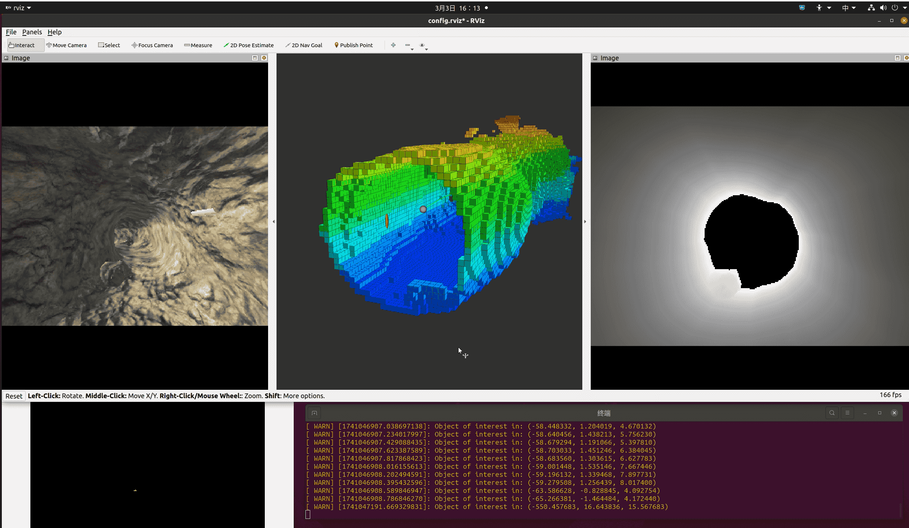
Objects of interest detector : detection process
Notes:
two ideas- one informed by using another

Slide 11
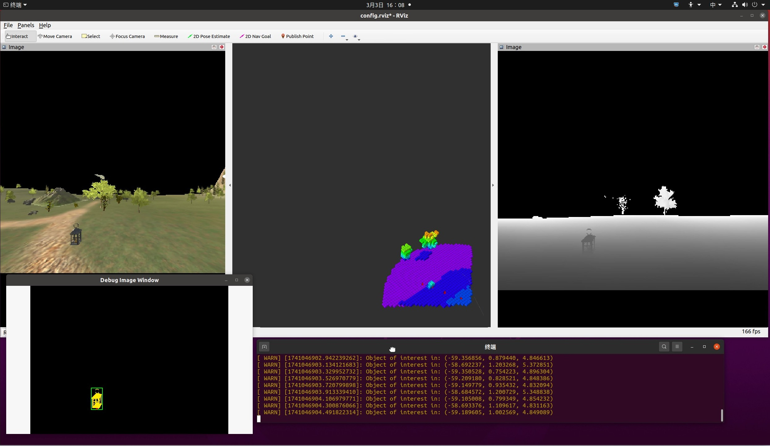
Objects of interest detector : detection results
Object - 1
Notes:
two ideas- one informed by using another

Slide 12
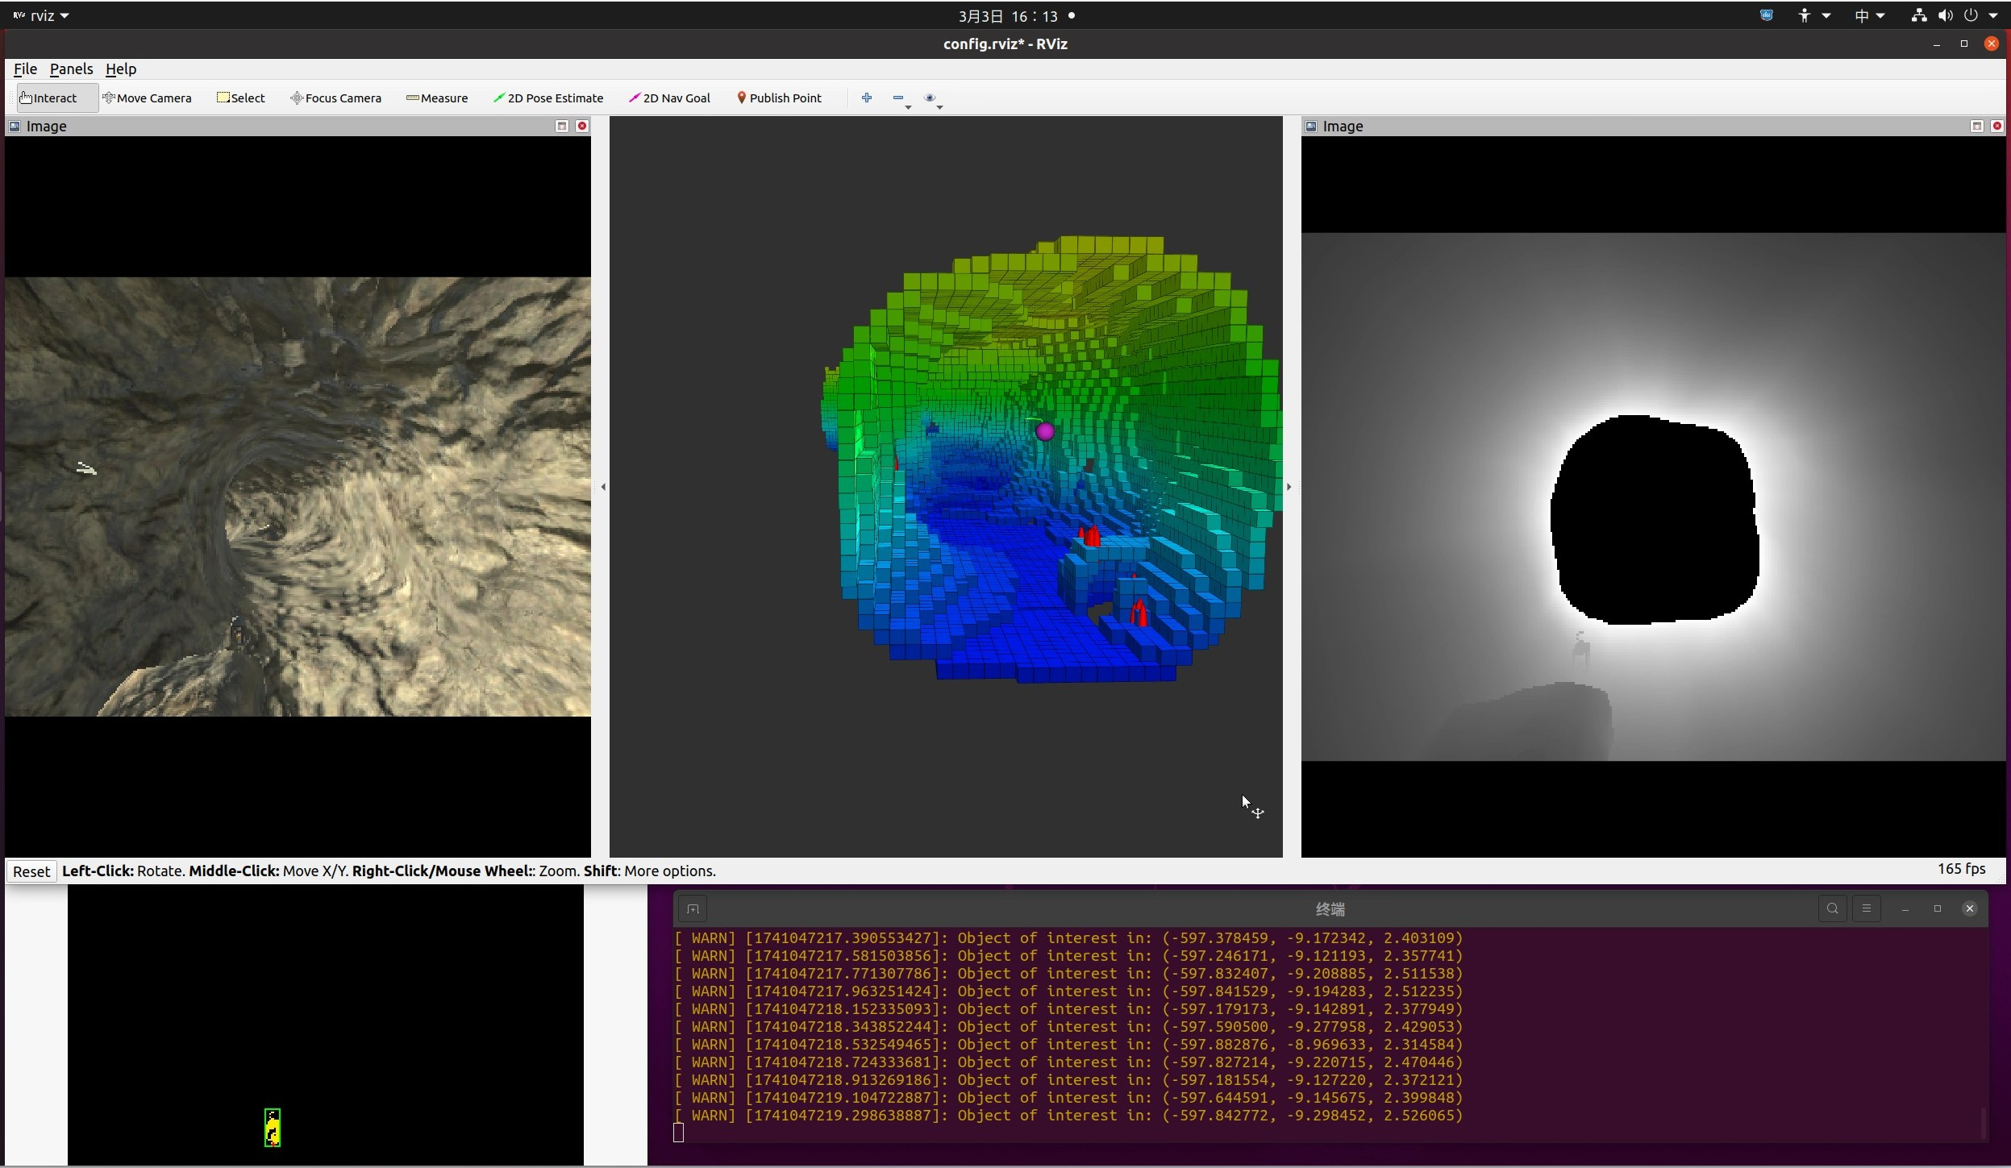
Objects of interest detector : detection results
Object - 2
Notes:
two ideas- one informed by using another

Slide 13
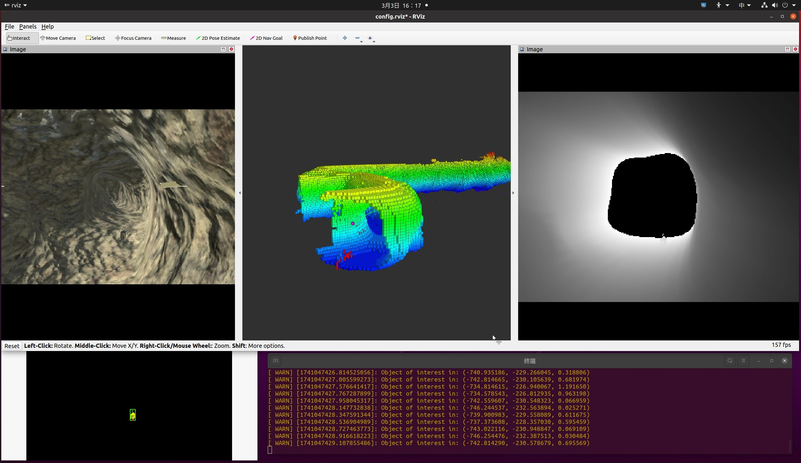
Objects of interest detector : detection results
Object - 3
Notes:
two ideas- one informed by using another

Slide 14
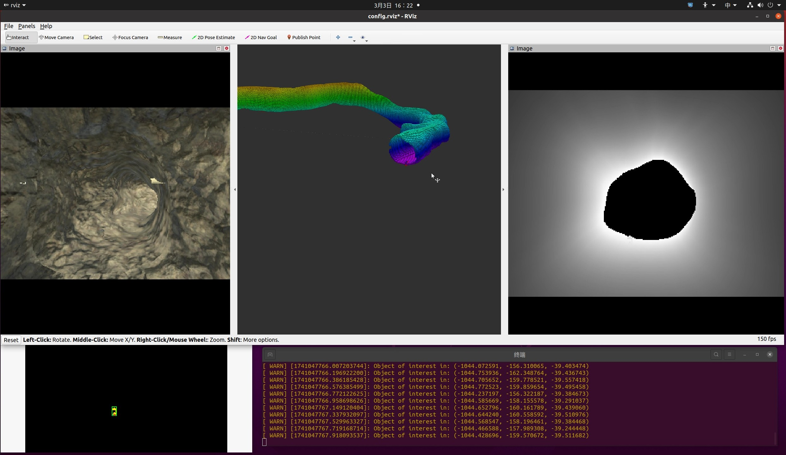
Objects of interest detector : detection results
Object - 4
Notes:
two ideas- one informed by using another

Slide 15
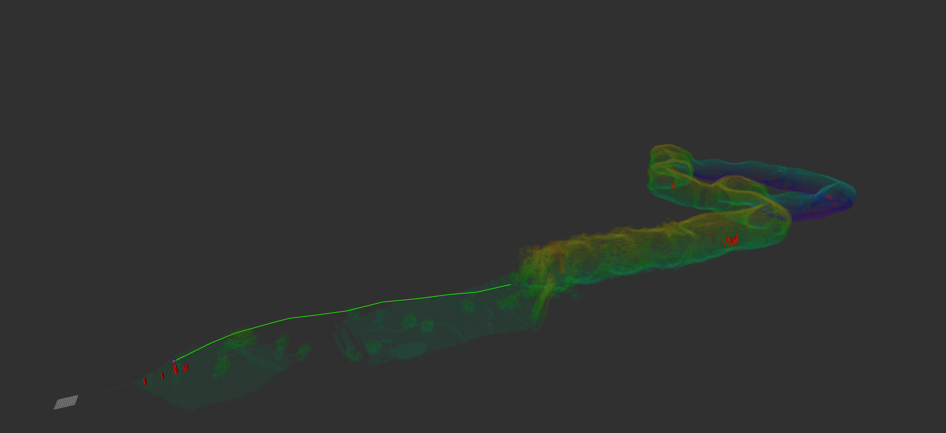
Objects of interest detector : detection results
The locations of objects on the map
Notes:
two ideas- one informed by using another

Slide 16
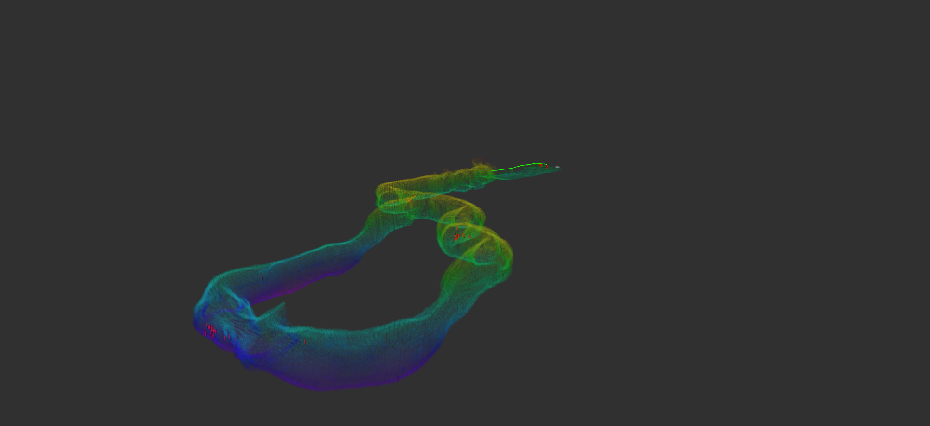
Objects of interest detector : detection results
The locations of objects on the map
Notes:
two ideas- one informed by using another

Slide 17
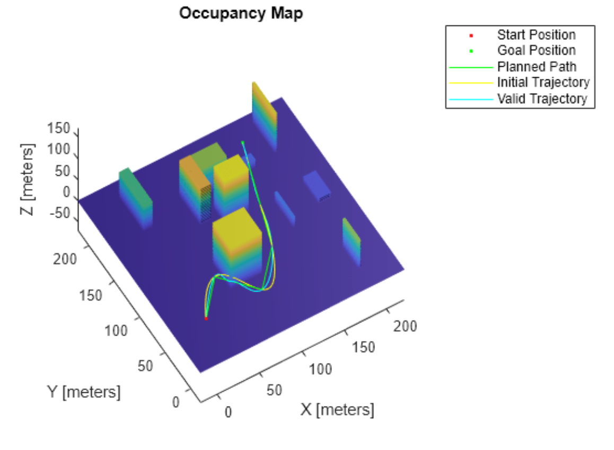
Trajectory generation
Plan trajectory
Given new waypoint
Generates a 10th-order Minimum Snap trajectory, ensuring smoothness and dynamic feasibility
Publish trajectory
Converts the optimized trajectory into ROS messages and publishes for execution & visualization
Advantages:
Smooth Trajectory
Dynamic Constraints
A* Based Path Planning

Slide 18

Geometric Controller
trajectory_pkg
desired_state
(xd, vd, ad)
Trajectory tracking
Quadrotor dynamics
propeller speed
(wrench)
Unity
Attitude tracking
tf
current_state
(x, v, omega)
Geometric controller
Notes:
two ideas- one informed by using another

Slide 19
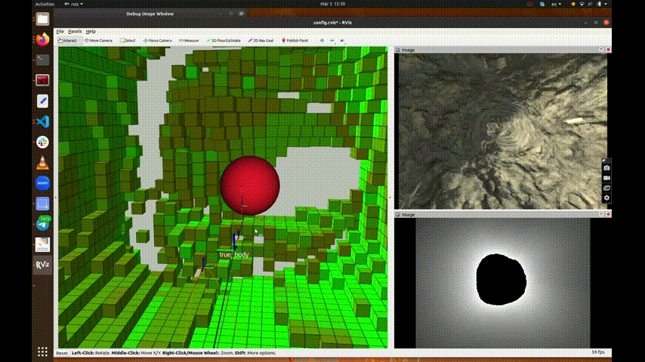
A* Path Planner & Frontier Detector

Slide 20
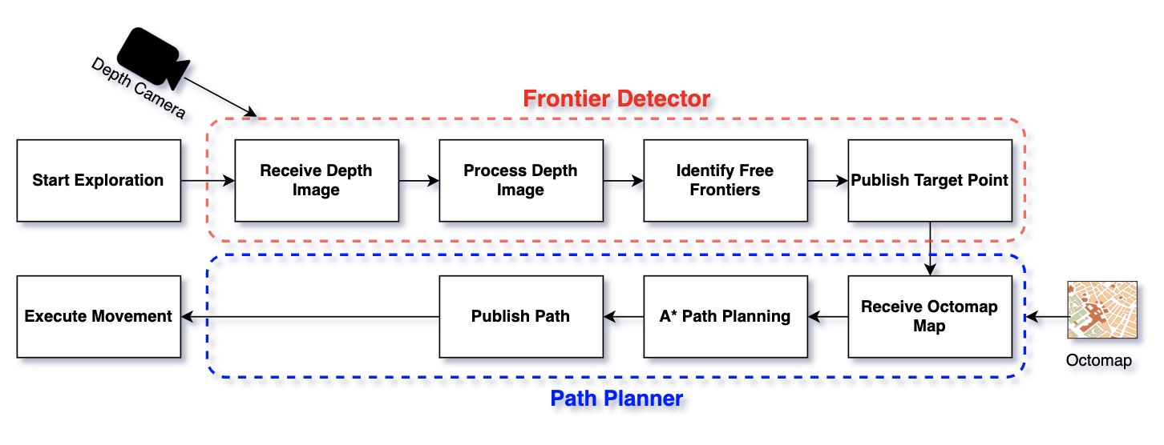
Why A* is Now Suitable (vs Before)
Previously Not Suitable:
A* struggled without a global map
Traditional A* requires a fixed goal, which is unsuitable for exploration
Static planner could not handle dynamic environments
Now Suitable:
Real-time Octomap provides up-to-date map
Dynamic frontiers detected and continuously passed to A*
Start and goal automatically adjusted if inside obstacles

Slide 21
Why not use RRT or other searching Algorithms？
Final Project-Team 11| AS | 24WS

Slide 22
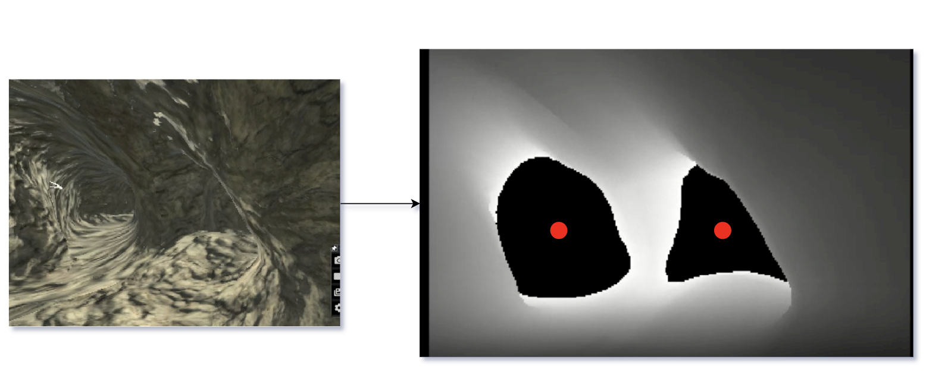
Frontier Detecter
Normalized the depth image
Detect all connected free regions as freespace
Filter out small regions (if area < threshold )
For each large region, find center
Save current position
Try each center as a goal, check if path exists
If all fail, backtrack as fallback
Final Project-Team 11| AS | 24WS

Slide 23
Frontier Detecter
u
Frontier_2
(0, 0)
v
d: the distance to frontier
Point position wrt. Camera frame
(pu, py, 1)_c: center pixel
Point position wrt. World frame
(cx, cy, 0)_c: camera
Depth frame
TF_W2C
(0, 0, 0)_w: World coordinate
Notes:
two ideas- one informed by using another

Slide 24
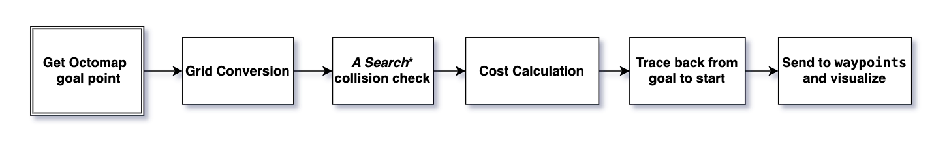
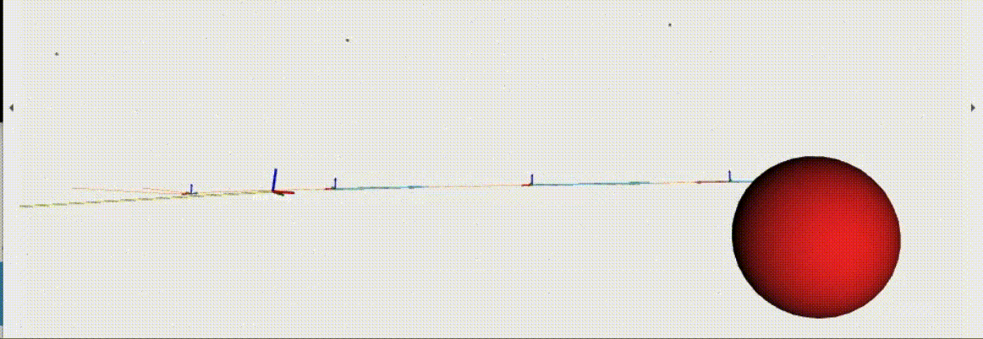
A* Path Planner

Slide 25
Hyperparameters Tuning
Kv
Kp
Kd
Max_velocity_UAV
Max_accerlation_UAV
N or in SNAP
max_velocity in SNAP
max_accleration in SNAP
Meter_depth_Camera
Distance to the frontier
Camera intrinsic
Trajectory Frequency
Controller Frequency

Slide 26
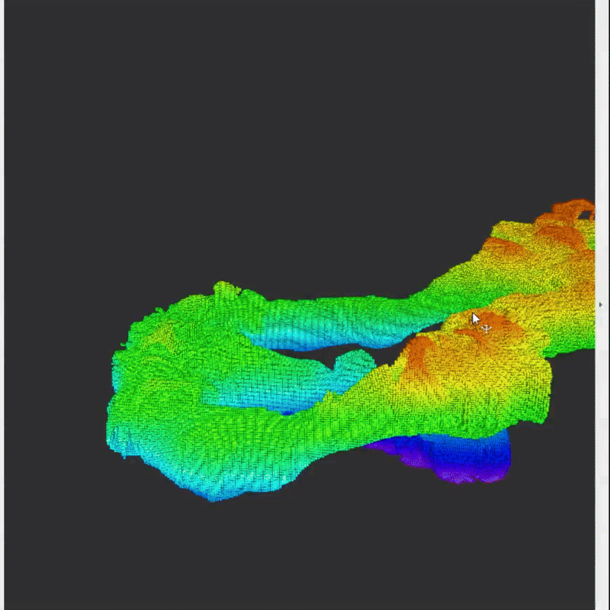
RESULT
Final Project-Team 11| AS | 24WS

Slide 27
Final Presentation Autonomous Systeme (LRG6300) 24WS Prof. Dr.-Ing. Markus Ryll
Thanks for your Listening!
Team 11
Siyan Li RCI
Bingkun Huang MRBE
Zhenjiang Li RCI
Haowen Shi MRBE
Weili Tang Aerospace
04. March, Technical University of Munich
Notes:
Glad

Slide 28
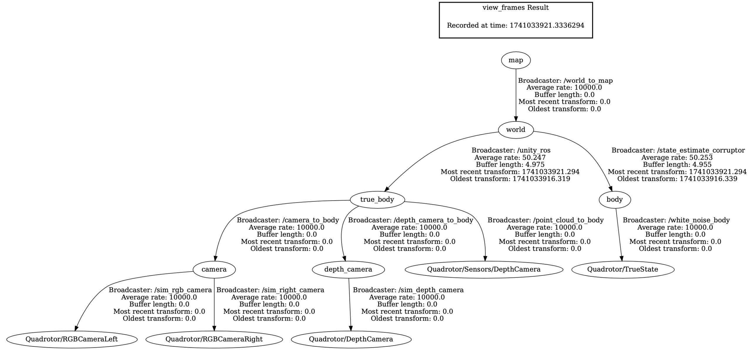
TF Tree

